Slide 1

C Programming Project Presentation
Project Title: ONLINE FOOD QUIZ SYSTEM
Course: Mini Project
Student Name & Roll No: SANJANA S
Department: Computer Science I’C’
Mentor / Guide:Mrs Selvi /Mr Mosses John Prakash

Slide 2
Introduction
C Programming Project Presentation
The Online Food Quiz System is a web-based interactive platform designed to test and enhance users' knowledge about food, nutrition, cuisines, and culinary culture. It offers a fun and educational experience through multiple-choice quizzes, trivia games, and timed challenges.

Slide 3
Objective
C Programming Project Presentation
Main goals of the project:
• To design and implement a C-based program to automate tasks
• To apply core programming logic and modular design
• To demonstrate problem-solving and analytical skills

Slide 4
Problem Statement
C Programming Project Presentation
Existing systems lack variety, personalization, and feedback.
Limited content and poor user experience.
Our system offers dynamic questions, instant feedback, and progress tracking

Slide 5
System Requirements
C Programming Project Presentation
Hardware Requirements:
• Processor: Intel i3 or higher
• RAM: 4 GB minimum
• Storage: 500 MB free space
Software Requirements:
• OS: Windows / Linux
• Compiler: GCC / Turbo C / Code::Blocks / Dev C++

Slide 6
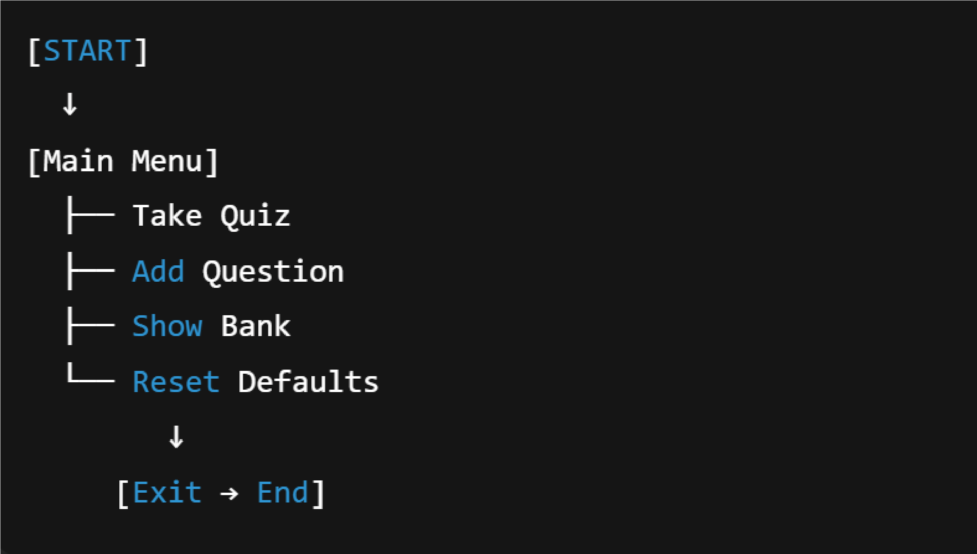
System Design
C Programming Project Presentation
Workflow: Login → Select Quiz → Answer Questions → Show Score
Flowchart

Slide 7
Module Description
C Programming Project Presentation
Input Module: Allows the user to select a quiz category and input answers to questions.
Processing Module: Evaluates the user's responses, calculates the score, and determines correctness.
Output Module: Displays feedback for each question, shows the final score, and provides learning insights.
File Handling Module: Stores user scores, quiz history, and retrieves past performance for progress tracking.

Slide 8
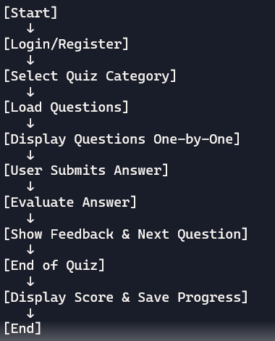
Algorithm / Flowchart
C Programming Project Presentation

Slide 9
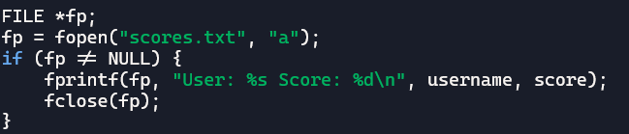
Implementation
C Programming Project Presentation
Loops and Conditional Statements: Used to navigate questions and evaluate answers.
Functions and Arrays: Modular design for quiz logic and storing questions.
File Handling: fopen, fclose, fprintf, fscanf used to save and retrieve scores.
Code snipper

Slide 10
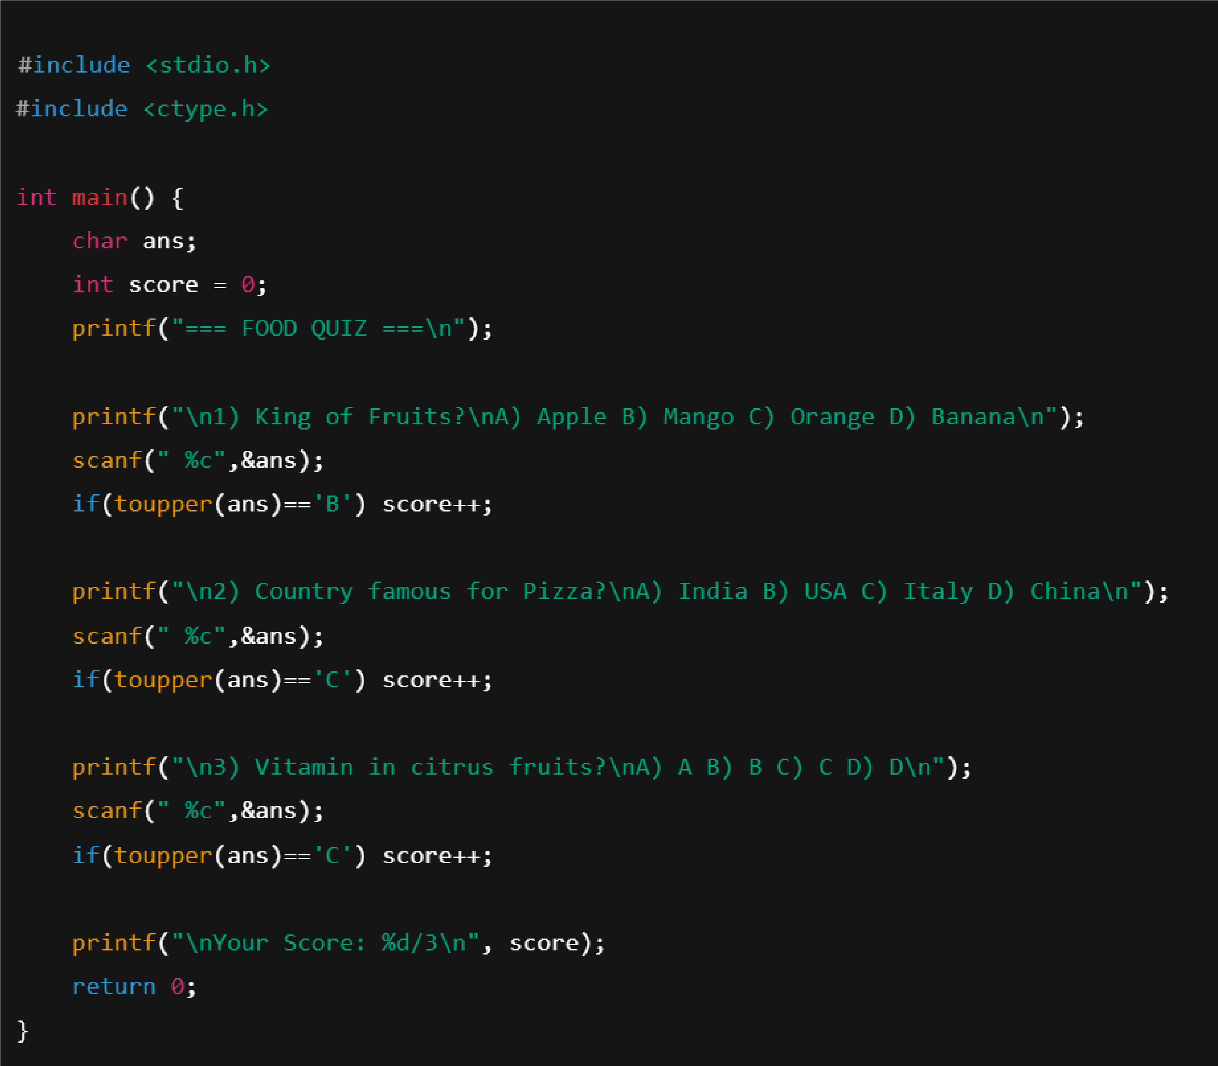
SAMPLE CODE
C Programming Project Presentation

Slide 11
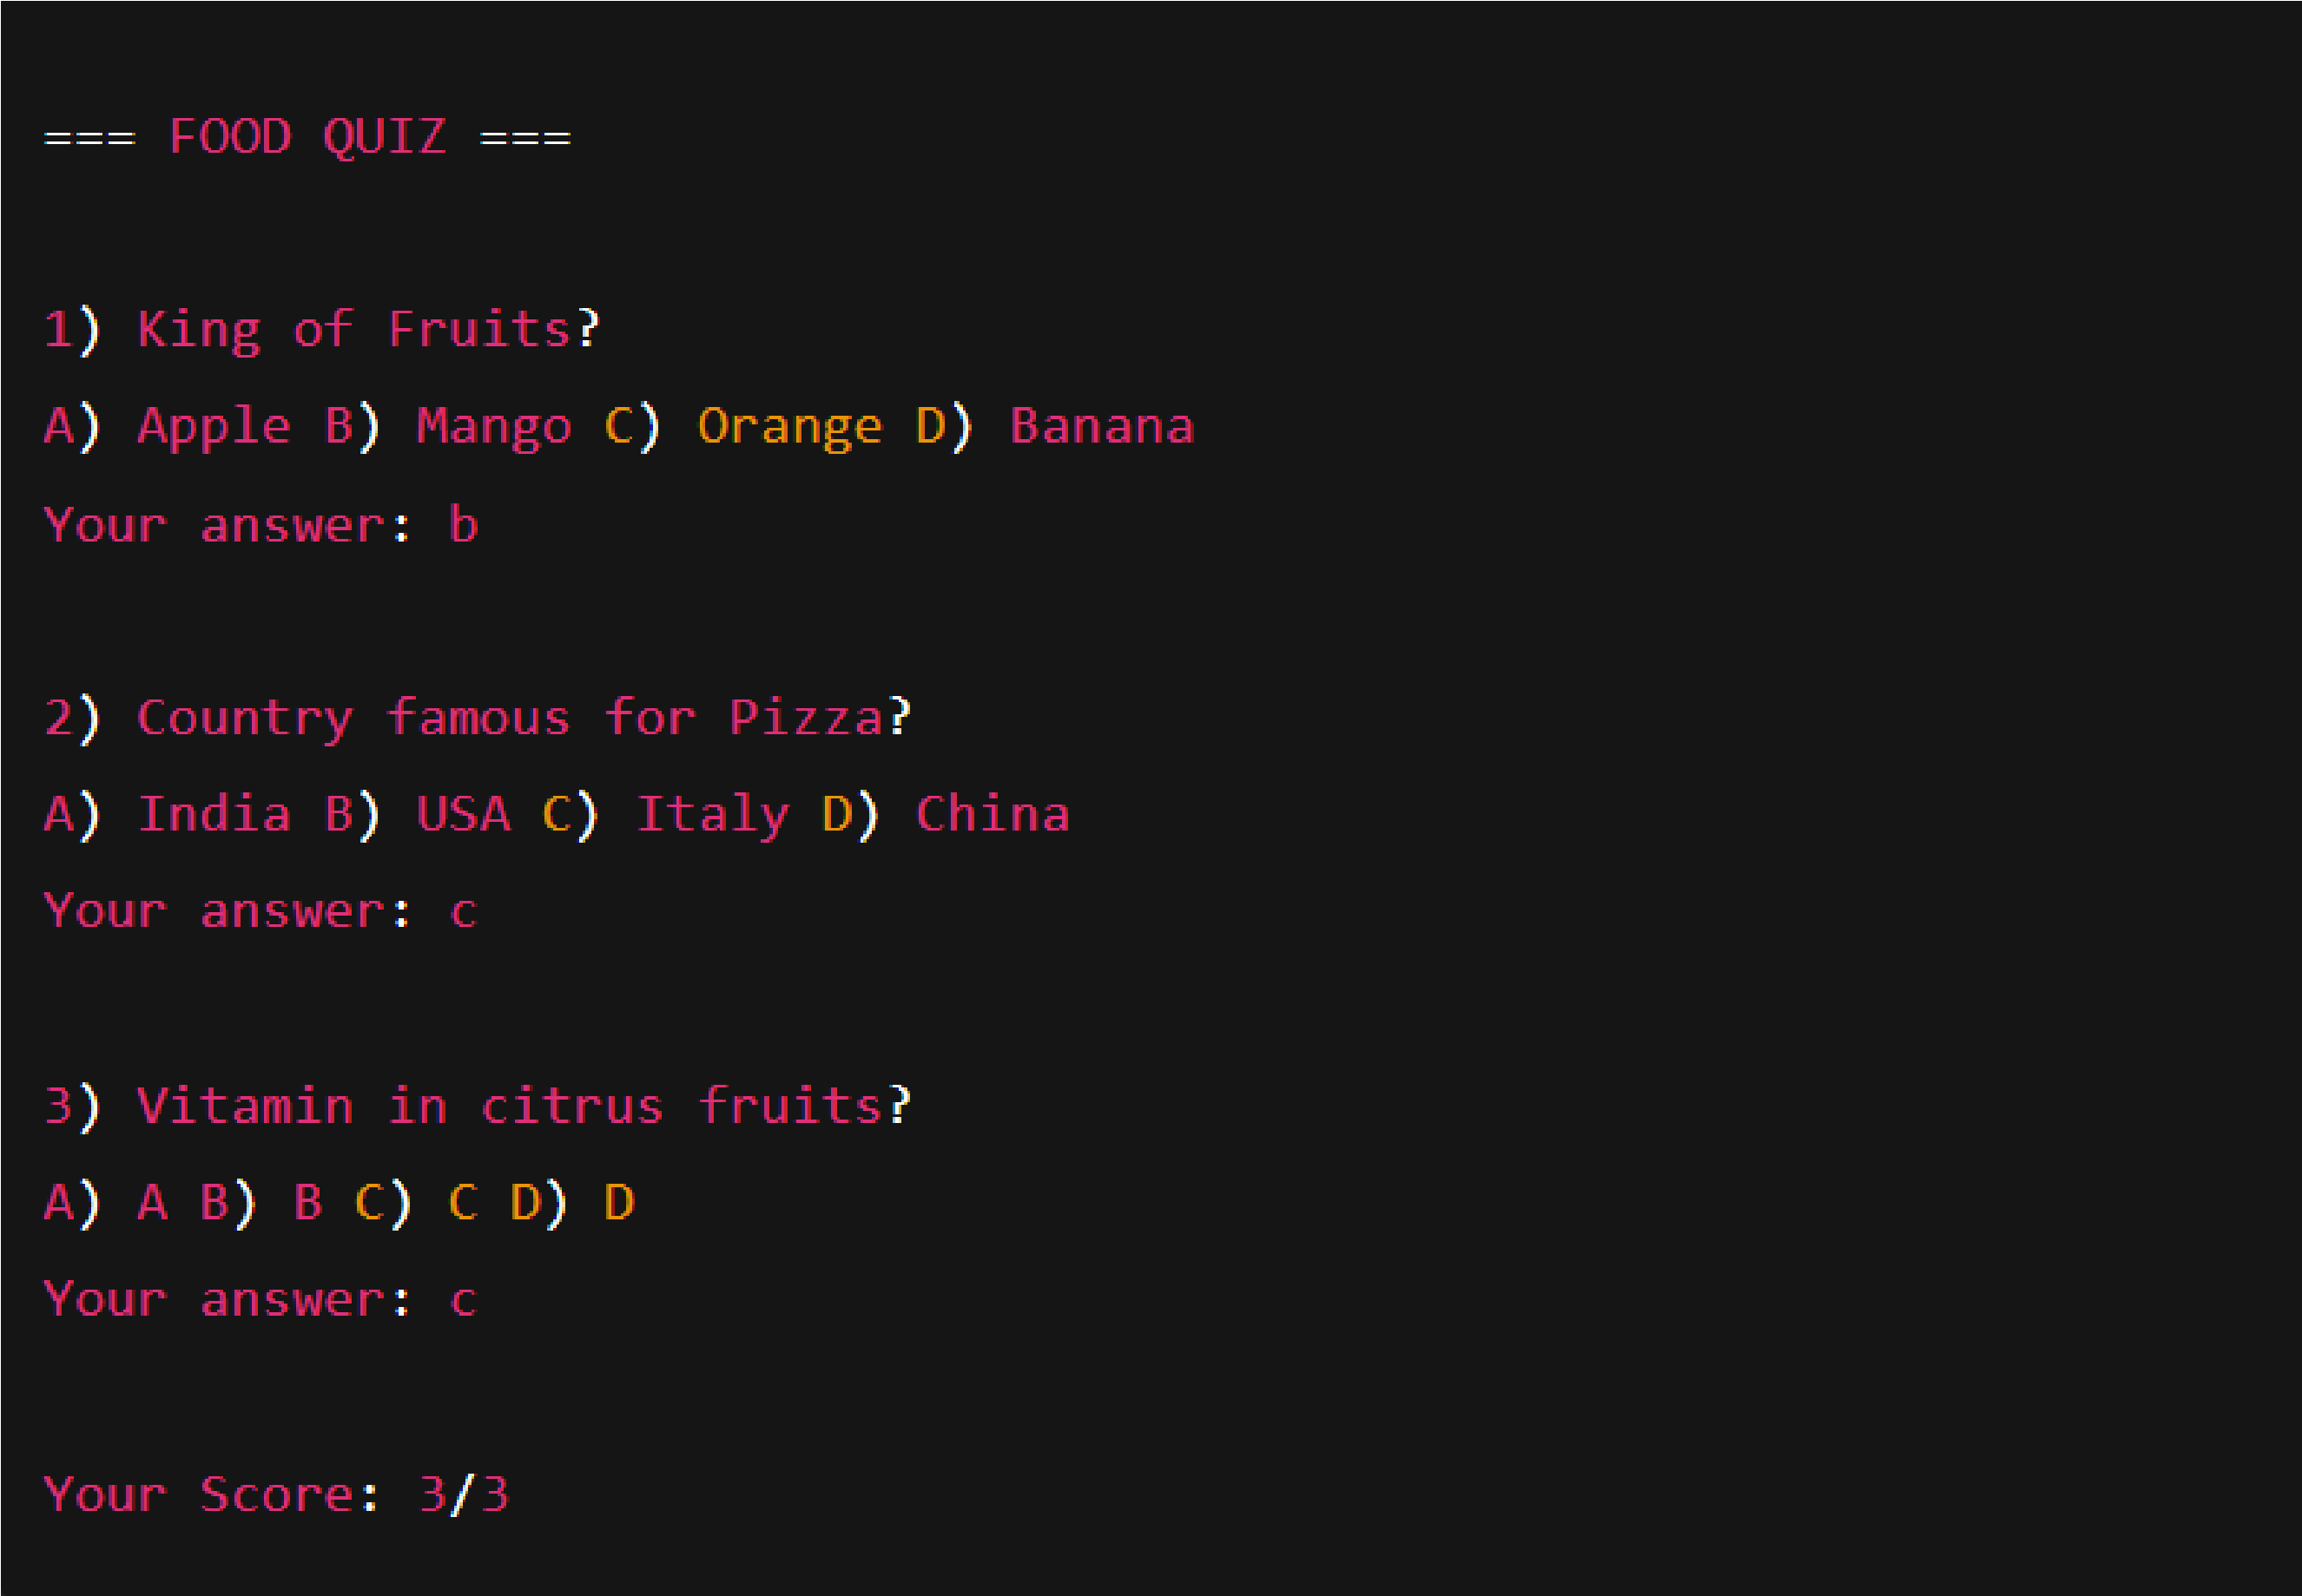
Output Screens
C Programming Project Presentation

Slide 12
Results & Discussion
C Programming Project Presentation
Summary of Outputs: The system successfully displays quiz questions, evaluates answers, and shows final scores with feedback.
Comparison with Expected Results: Output matches the intended logic and scoring criteria, confirming correct implementation of quiz flow.
Accuracy and Performance Observations: The system performs reliably with accurate answer evaluation and efficient file handling for score storage.
Challenges Faced & Resolutions: Faced issues with randomizing questions and managing file access. Resolved by modularizing code and using proper file handling techniques

Slide 13
Conclusion & Future Enhancement
C Programming Project Presentation
Conclusion:
• Project achieved intended objectives
• Improved understanding of C concepts and system design
Future Enhancements:
• Add GUI support
• Integrate with database
• Extend functionality for scalability

Slide 14
References / Acknowledgement
C Programming Project Presentation
References:
• Let Us C – Yashavant Kanetkar
• C Programming – E. Balagurusamy
• Online resources and documentation
Acknowledgement:
• Express gratitude to mentor, department, and team members

Slide 15
Thank You
Closing Remark / Project Motto: "Eat smart, learn fast — one quiz at a time!"
Questions & Discussions: We welcome your feedback and are happy to answer any questions.

